Slide 1


IT343: Operating System
July – November 2020
Chapter – 7(Part-1)
Memory Management
Devang Patel Institute of Advance Technology and Research

Slide 2
Memory
Memory refers to the devices used to store information for use in a computer.
Functionality of computer system is execution of program
The functionality of memory is Storing.
Memory is technically any form of technical storage.
The basic operations of memory is read and write.

Slide 3
Organization of memory
Memory is organized into cell. Each cell will be uniquely identified by unique number, called address.
Based on the number of cells , we can determine the number of address lines.
Based on the number of address lines, we can determine the address space of memory chip.

Slide 4
How to access memory to execute a program
Program usually stored in memory
To execute the program there is a need of accessing the instruction from memory
To access the memory, CPU will generate the memory request
The memory request contain address along with control signal
Control signals of memory are read and write

Slide 5
Memory Management
Three important criteria for memory :
Size
Access Time
Per unit Cost

Slide 6
To achieve all the criteria we can use memory hierarchy .
CPU
Cache Memory
Main Memory
Disk
Computer Science: A Structured Programming Approach Using C

Slide 7
How actually level of memory works?
That concept known as locality of reference.
Ex:
When you execute program it execute in the sequence… Let’s assume that p1 program have total 1000 instruction.
Nature of program: Sequential
Can we Violate sequential nature ?

Slide 8
Ex: Suppose SM access time 100ms
Suppose MM access time 10 ms
As per the locality of reference always data find in MM
Heat ratio : 90%
= .9(10) + .1(100+10)
= 9+11
=20 ms.
Computer Science: A Structured Programming Approach Using C

Slide 9
Basic Concepts
Registers are generally accessible within one cycle of CPU clock
On the other hand access to main memory take more than one CPU cycle
This situation is intolerable because of the frequency of memory access
The remedy is to add fast memory i.e. cache memory between the CPU and main memory

Slide 10
Memory Management
Action to manage the memory of computer system using various methods like partitions, paging, segmentation and virtual memory is called memory management.

Slide 11
Memory Management
Function
Goal
Allocation
Protection
Free Space Management
De-allocation
Minimize the wastage (fragmentation)
Run larger process in smaller memory (Virtual memory)

Slide 12
Logical vs. Physical Address space
The concept of a logical address space that is bound to a separate physical address space is central to proper memory management
  Logical address (LA) – generated by the CPU; also referred to as virtual address
  Physical address (PA)– address seen by the memory unit

Slide 13
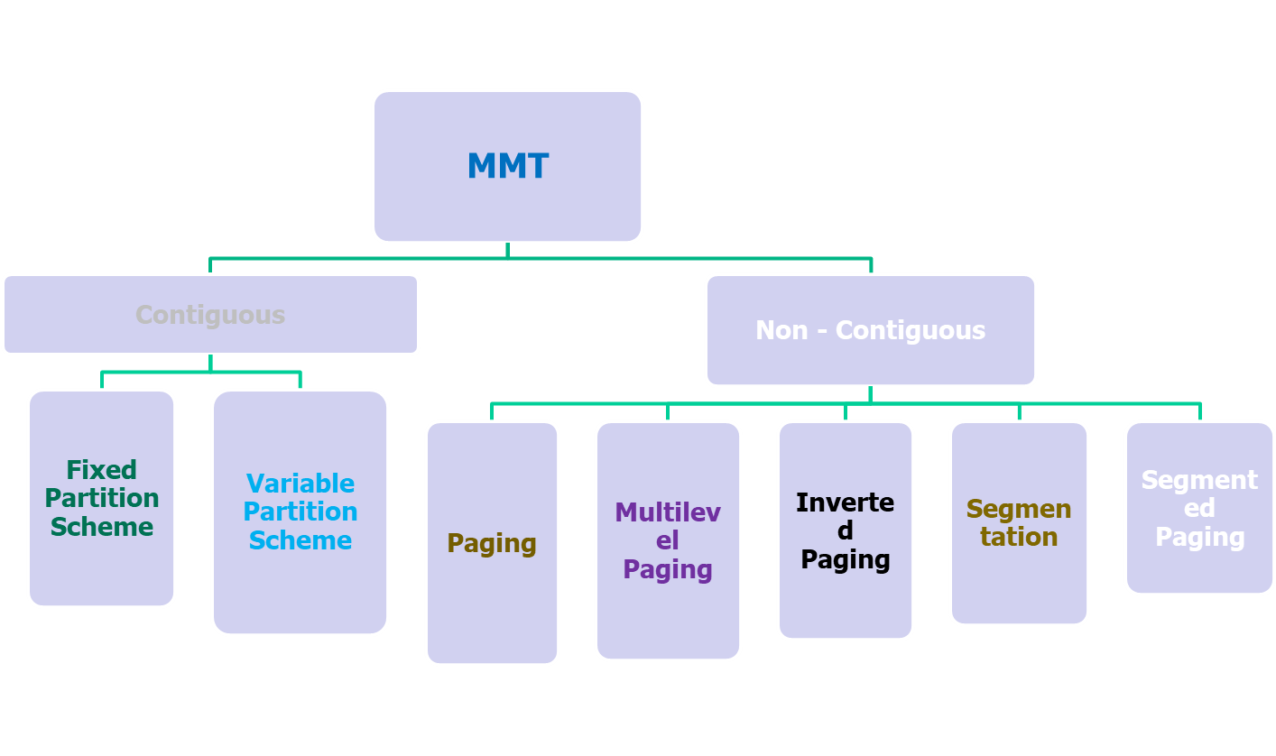
Memory Management Techniques (MMT)

Slide 14
Type of Memory Allocation
There are 2 types of memory allocation:
Contiguous memory allocation(centralized)
Non – Contiguous memory allocation(distributed approach)

Slide 15
Contiguous Memory Allocation
Contiguous memory allocation is known as a memory allocation model in which each program is allocated a single contiguous adjoining area in the memory
The contiguous memory allocation scheme can be implemented in operating systems with the help of two registers, known as the base and limit registers.

Slide 16
ways of partitioning in contiguous memory allocation
Partitioning of memory can be done in the following ways-
Single process monitor
Multiprogramming with fixed partition
Multiprogramming with variable partition

Slide 17

Single Process Monitor
Main memory(1000MB) is dividing into the two parts
One is part of O.S. and second for user process area.
0
500MB
999 MB

Slide 18
Single Process Monitor
Here main memory 0-500MB space is reserve for the Operating System.
Second part is part for user process in which user’s process will be loaded into memory
In Single Process Monitor only one process can load into memory
when one process will complete then next process will loaded into memory
Single process monitor does not support multiprogramming, but supports only uniprogramming

Slide 19
Multiprogramming with Fixed Partition (MFT)
To support the multiprogramming the main memory is dividing into multiple partitions
The number of partitions are fixed but the size of each partition can be different
Each process will store into these partitions contiguously.
Here only one process is allowed into one partition.
Degree of Multiprogramming is equivalent to the number of partitions as many processes can be existed into main memory at one time

Slide 20


0
0
500
500
600
650
700
750
800
800
900
999
999
MFT with equal-size partition
MFT with unequal-size partition

Slide 21
Multiprogramming with Fixed Partition (MFT)
In fig.1 memory is divided into 5 equal size partitions. Each partition of 100MB.
In fig.2 memory is divide into 4 unequal size partitions. Partition size is not equal.
Operating system will load the more than one process into the partitions.
If no free partition is available, then any process with lower priority can be swapped out to make room for a higher priority process

Slide 22
Problems with fixed partitioning
Main problem with this arrangement is fragmentation.
Fragmentation is the presence of unusable areas in the computer memory
There are two types of fragmentation
1) Internal Fragmentation
2) External fragmentation

Slide 23
Internal Fragmentation: It arises when the memory allocated to program is not fully utilized by it. This form of fragmentation occurs whenever the size of program does not match with the size of partition
Definition: Difference between total space of partition and space occupied by process is called internal fragmentation.

Slide 24

Internal fragmentation
0
Here p1, p2,p3,p4 is loaded into memory
Process P1 is loaded into first partition whose size is 150MB and size of process P1 is 110MB ,so in partition 40MB space is waste.
This is called Internal Fragmentation, this type of problem is also occurred in other partitions.
150
165
175
180
999

Slide 25
External Fragmentation
External Fragmentation: It arises when free memory areas existing in the system are too small to be allocated to programs
0
p1
P2
P3
P4
P5
P6
P7
p8
30
100
150
270
520
820
990
999

Slide 26
External Fragmentation
If P1 is completed its execution it deallocates the memory and P3 is also completed its execution so it also deallocates its memory.
So total available memory = 50k + 30k = 80k
Suppose P9 of size 60 is new process to be allocated, but this allocation is not possible
This kind of memory un-utilization is called External fragmentation

Slide 27
Strategies to allocate Process into memory
There are many strategies to allocate processes into free memory partitions
First Fit
Best Fit
Worst Fit

Slide 28
First Fit: Allocate first free partition which is enough for process. Searching will be start from first partitions.
Best Fit: Allocate the small free partition which is small and enough for process. Here all partition will be search from top to bottom and allocate the partition in which less amount of waste of space.
Worst Fit: Allocate the largest partition in which high amount of waste of space, here all partitions will be search from top to bottom.

Slide 29
First Fit Allocation
To allocate n bytes, use the first available free block such that the block size is larger than or equal to n.
1K bytes
2K bytes
2K bytes
To allocate 400 bytes,
we use the 1st free block
available
500 bytes
500 bytes

Slide 30
First Fit Allocation
Advantages
Simple
Tends to produce larger free blocks toward the end of the address space
Disadvantages
Internal fragmentation

Slide 31
Best Fit Allocation
To allocate n bytes, use the smallest available free block such that the block size is larger than or equal to n.
1K bytes
1K bytes
2K bytes
2K bytes
To allocate 400 bytes,
we use the 3rd free block
available (smallest)
500 bytes

Slide 32
Best Fit Allocation
Advantages
Works well when most allocations are of small size
Relatively simple
Disadvantages
Internal fragmentation
Slow allocation
Slow deallocation
Tends to produce many useless tiny fragments (not really great)

Slide 33
Worst Fit Allocation
To allocate n bytes, use the largest available free block such that the block size is larger than or equal to n.
1K bytes
1K bytes
2K bytes
To allocate 400 bytes,
we use the 2nd free block
available (largest)
500 bytes
500 bytes

Slide 34
Worst Fit Allocation
Advantages
Works best if allocations are of medium sizes
Disadvantages
Internal fragmentation
Tends to break large free blocks such that large partitions cannot be allocated

Slide 35
Advantages and Disadvantages of Fixed partition
Advantage :
-- simple to implement
Disadvantages :
-- Problem of internal fragmentation.
--Not efficient use of memory.

Slide 36
Example-1
Consider a main memory having following partition size
330B, 100B, 200B, 400B, 500B (in order) and
following process are waiting block of size
120B, 300B, 100B, 250B, 350B (in order)
Apply
First-Fit allocation
Best-Fit allocation
Worst-Fit allocation
Calculate the total internal fragmentation in each allocation strategy?

Slide 37
Example-2
Consider five memory partitions of size 100 KB, 500 KB, 200 KB, 450 KB and 600 KB in same order. If sequence of requests for blocks of size 212 KB, 417 KB, 112 KB and 426 KB in same order come, then which of the following algorithm makes the efficient use of memory?
A. Best fit algorithm
B. First fit algorithm

Slide 38
Multiprogramming with Variable partition
To avoid the difficulties of fixed partitions, partitions are created dynamically.
In Dynamic partitions, no partition is fixed into memory but the partition are created only when process is loaded into memory
The partitions size is exactly size of process.
If process size is 125MB, when process will enter into memory then 125MB size partition will be created.

Slide 39

There are 6 processes p1, p2, p3, p4, p5, p6 and size of user process area is 500MB which is currently free and no any partition in main memory.
0
Size of each process is as following:
p1 – 110 MB
p2 – 80MB
p3 – 40MB
p4 – 120MB
p5 – 100MB
p6=150MB
500
1000

Slide 40
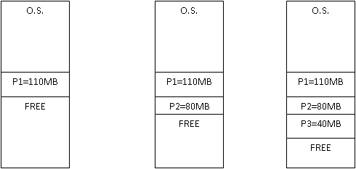
When process will load than the partition will be created as per size of process.
0
0
0
500
500
500
610
610
610
690
690
730
1000
1000
1000
[ Loading of p1 ]
[ Loading of p2 ]
[ Loading of p3 ]

Slide 41
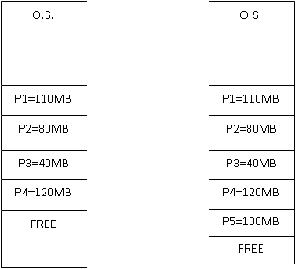
0
0
500
500
610
610
690
690
730
730
850
850
950
1000
1000
External
fragmentation
[ Loading of p4 ]
[ Loading of p5 ]

Slide 42
Multiprogramming with variable partitions
In our example, size of process P1 is 110 MB, so partition of 110 MB will be created for process P1. Same procedure will repeat for all processes.
Here every process will be loaded into memory dynamically and partition will be created exactly as size of process.
Here 5 processes can be loaded dynamically. And at last process p6 cannot be loaded because there is not enough space in memory to load process P6, so space of 50MB will be wasted in memory. This is called external fragmentation.
Here the not problem of internal fragmentation. But here the problem of external fragmentation.

Slide 43
Advantage & Disadvantage of Dynamic Partition
Advantage: -
--no internal fragmentation.
-- Efficient use of memory.
Disadvantage:
-- problem of external fragmentation.
-- Not easy to implement.
Compaction is needed !!

Slide 44
Compaction
Compaction is one of the technique to avoid External Fragmentation
Move all the processes towards the top or towards the bottom to make free available space in a single contiguous block is known as compaction
Compaction is undesirable to implement because it interrupts all the running processes in the main memory
The other technique to avoid external fragmentation is to implement non-contiguous memory allocation techniques

Slide 45
compaction
OS
P1 12 KB
<FREE> 10 KB
P2 20 KB
P4 3 KB
<FREE> 13 KB
P3 6 KB
<FREE> 4 KB
Memory mapping before compaction
P5 of 15KB can not be loaded

Slide 46
compaction
OS
P1 12 KB
P2 20 KB
P4 3 KB
P3 6 KB
Swap out
P2

Slide 47
compaction
OS
P1 12 KB
P2 20 KB
P4 3 KB
P3 6 KB
Swap in
P2
Secondary
storage

Slide 48
compaction
OS
P1 12 KB
P2 20 KB
P4 3 KB
P3 6 KB
Secondary
storage
Swap out
P4

Slide 49
compaction
OS
P1 12 KB
P2 20 KB
P4 3 KB
P3 6 KB
Swap in
P4 with a different starting address
Secondary
storage

Slide 50
compaction
OS
P1 12 KB
P2 20 KB
P4 3 KB
P3 6 KB
Secondary
storage
Swap out
P3

Slide 51
compaction
OS
P1 12 KB
P2 20 KB
P4 3 KB
P3 6 KB
Swap in
P3
Secondary
storage

Slide 52
compaction
OS
P1 12 KB
P2 20 KB
P4 3 KB
P3 6 KB
<FREE> 27 KB
Memory mapping after compaction
Now P5 of 15KB can be loaded here

Slide 53
compaction
OS
P1 12 KB
P2 20 KB
P4 3 KB
P3 6 KB
P5 12 KB
<FREE> 12 KB
P5 of 15KB is loaded

Slide 54
Address Translation
CPU-→ LA-→PA
Limit Register
Relocator Register
MM
SM
LA
<
Yes
+
CPU
trap
Computer Science: A Structured Programming Approach Using C

Slide 55
Part-1 Completed
Next-
Non Contiguous Memory Allocation

